Slide 1
The Rise of the Internet
Geoff Huston

Slide 2
The Rise of the Internet
and Fall
Geoff Huston

Slide 3
It was thirty years ago today…
On Sunday 23rd June 1989 we commissioned a permanent IP link between the the University of Melbourne and the University of Hawaii, using a 56Kbps satellite link
The Internet had arrived in Australia
And almost nobody noticed

Slide 4
Over these thirty years…
We seen the inexorable and rise of the Internet weaving its way into the very fabric of our lives:
  From FTP to WAIS to the Web to apps
  From data to search to streaming
  From mainframes, to workstations to desktops to mobile devices
  From bits to megabits to gigabits
And we’ve seen optimism and hope turn to disillusion and distrust
All in just thirty years
How did we get here?

Slide 5
The Victorian Internet – the Telegraph
In 1800 Alessandro Volta invented the battery that allowed electricity to be used in a controlled manner
In 1820 Hans Christian Oersted demonstrated the connection between electric current and magnetism
In the 1830’s in the UK William Cooke and Charles Wheatstone used a system of five pointers to send text - the first use was railway signalling in the UK
In the 1840’s Samuel Morse developed a simpler system using a keypad to complete a circuit.
By 1861 telegraph lines spanned the US
By 1870 an undersea cables spanned the Atlantic

Slide 6
The Great Telegraph Boom
The period from the 1850’s to the 1900 saw major investments in national and international telegraph cable systems
Most of the initial international investment activity was from the UK – by 1982 British companies owned and operated two thirds of the world’s telegraph cables.
In the US newspapers expanded 5-fold in the period 1840 – 1860 as 50,000 miles of telegraph cable were installed
When combined with the railway this became a effective means for the projection of power and control – enterprises saw opportunities in extensive reach, creating private monopolies to complement the older state-sponsored monopolies

Slide 7
Australia: The Overland Telegraph
Spanning 3,200kmm, and completed in 1872, it was the greatest engineering feat of 19th century Australia
The first message sent directly from London to Adelaide occurred on 22 October 1872.
A thirty word telegram:
  cost the equivalent of 3 weeks working man’s wages
  Had a 30% error rate due to transcription errors at repeater stations
  Could not use compression or encryption
Even so, the impact in Australia was transformational

Slide 8
The Next Wave: the Telephone
First shown to the world at the 1876 World Exposition at Philadelphia, its invention triggered a struggle to the death between Western Union’s telegraph and Bell’s telephone
Although Western Union never fully appreciated that the telephone was an existential threat to the telegraph until it was simply too late.
Thousands of regional telephone companies appeared all over the world in the following years

Slide 9
The Formation of the Telephone Cartel
Theodore Vail - President of American Telephone and Telegraph (twice!) - oversaw the construction of a national monopoly masquerading as a public utility through the Kingsbury Commitment with US Congress in 1913
AT&T divested itself of Western Union Telegraph and in return created a substantial private monopoly under the catch cry of “one policy, one system and one universal service”
Other countries emulated this transformation from competition to national monopoly in just a few years, using existing telegraph monopoly to subsume telephone operators into public utility structures

Slide 10
And then the telephone story stopped
The telephone network was constructed to match the human voice
  And that’s all it did
Almost nothing changed: Telephone innovations were deployed early on in the story of telephone
  The Stroger Automatic Exchange was invented in 1891
  The Fax dates back to 1843
  And there was the Speaking Clock of course
  And not much else!
While telephone companies monopolized technology, they did so in a defensive stance
Meanwhile, the phone companies’ research labs invented the transistor, switching, DACs, packet networking, ciphers, radio astronomy, television, solar cells, C, Unix, microprocessors

Slide 11
Meanwhile…

Slide 12
Computer Networks
Computer Networks

Slide 13
Computer Networks
The original concept for computer networks was the telephone network
  The network was there to enable connected computers to exchange data
    All connected computers were able to initiate or receive “calls”
    A connected computer could not call ”the network” – the network was an invisible common substrate
    It made no difference if the network had active or passive internal elements
There is a story about the protocol wars of the late 1980’s but that’s a story for another day – let’s just fly over that with the observation that IP won!

Slide 14
Internet Architecture
Inverted network design:
  The network switching function was stateless
    No virtual circuits, no dynamic state for packets to follow
  Single network-wide addressing and routing model
  Simple datagram unreliable datagram delivery paradigm
  All functionality was removed form the network and relocated to the end device

Slide 15
The Result was Revolutionary!
  By stripping out network-centric virtual circuit states and removing time synchronicity the resultant packet carriage network was minimal in design and cost and maximized flexibility
  More complex functions, such as flow control, jitter stability, loss mitigation and reliability, were pushed out to the attached devices on the edge
  But it was more than just a technology shift
  It was a revolution!

Slide 16
The Stages of Revolution
Disruption of the Ancien Regime

Slide 17
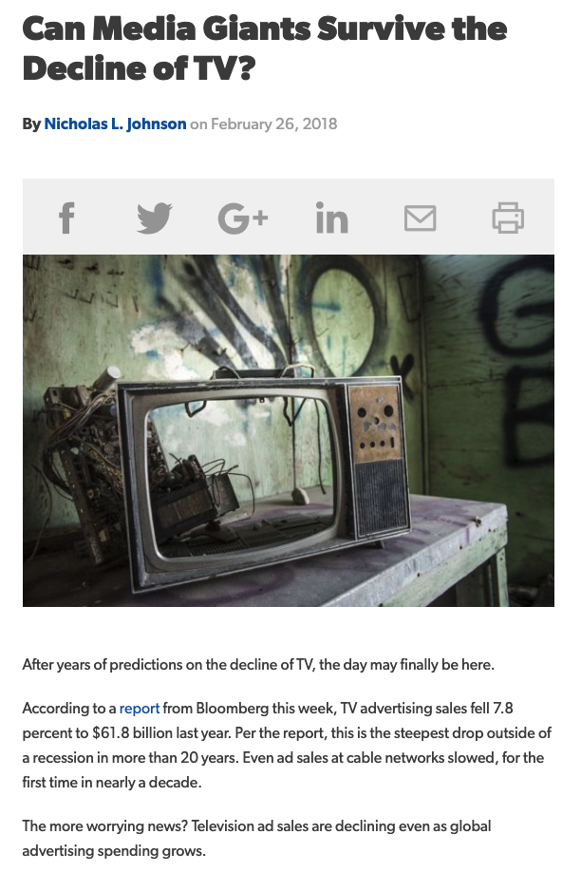


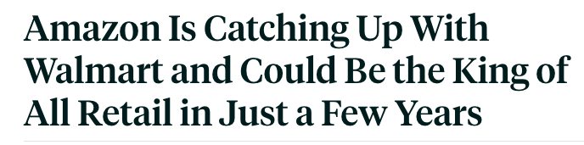
Demise of the Old Order
Maybe only the incumbents saw the existential threats in the early days, but the threats were very real
The waning of free-to-air broadcast television
The decline of the press
Reshaping retail channels

Slide 18
The Stages of Revolution
Disruption of the Ancien Regime
The Chaos of Revolution

Slide 19

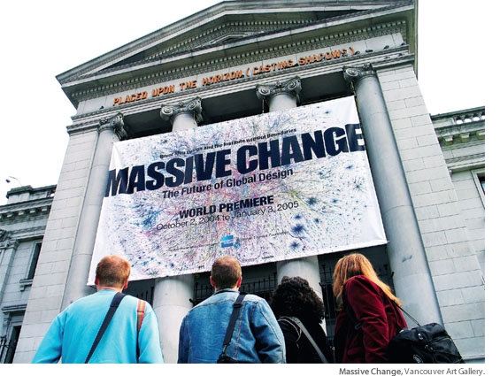

The New Digital Economy
The Internet enabled a shift in the way goods and services were traded, enabling the single person global entrepreneur
Massive reach across global markets no longer requires huge resources
  In 1997 Telstra served ~5M customers with 77,000 employees
  Facebook has 2.3B users and 30,000 employees

Slide 20
The Darker Side of Digital Chaos
Social Networking turns sour with allegations of stolen elections
DDOS attack turns on terabit intensity
Hacking turns to organised crime
Cyber warfare turns real
The Internet’s basic security framework is ineffective against well resourced nation state attackers practising sophisticated digital disruption attacks
The Internet is now a toxic wasteland that glows in the dark!

Slide 21
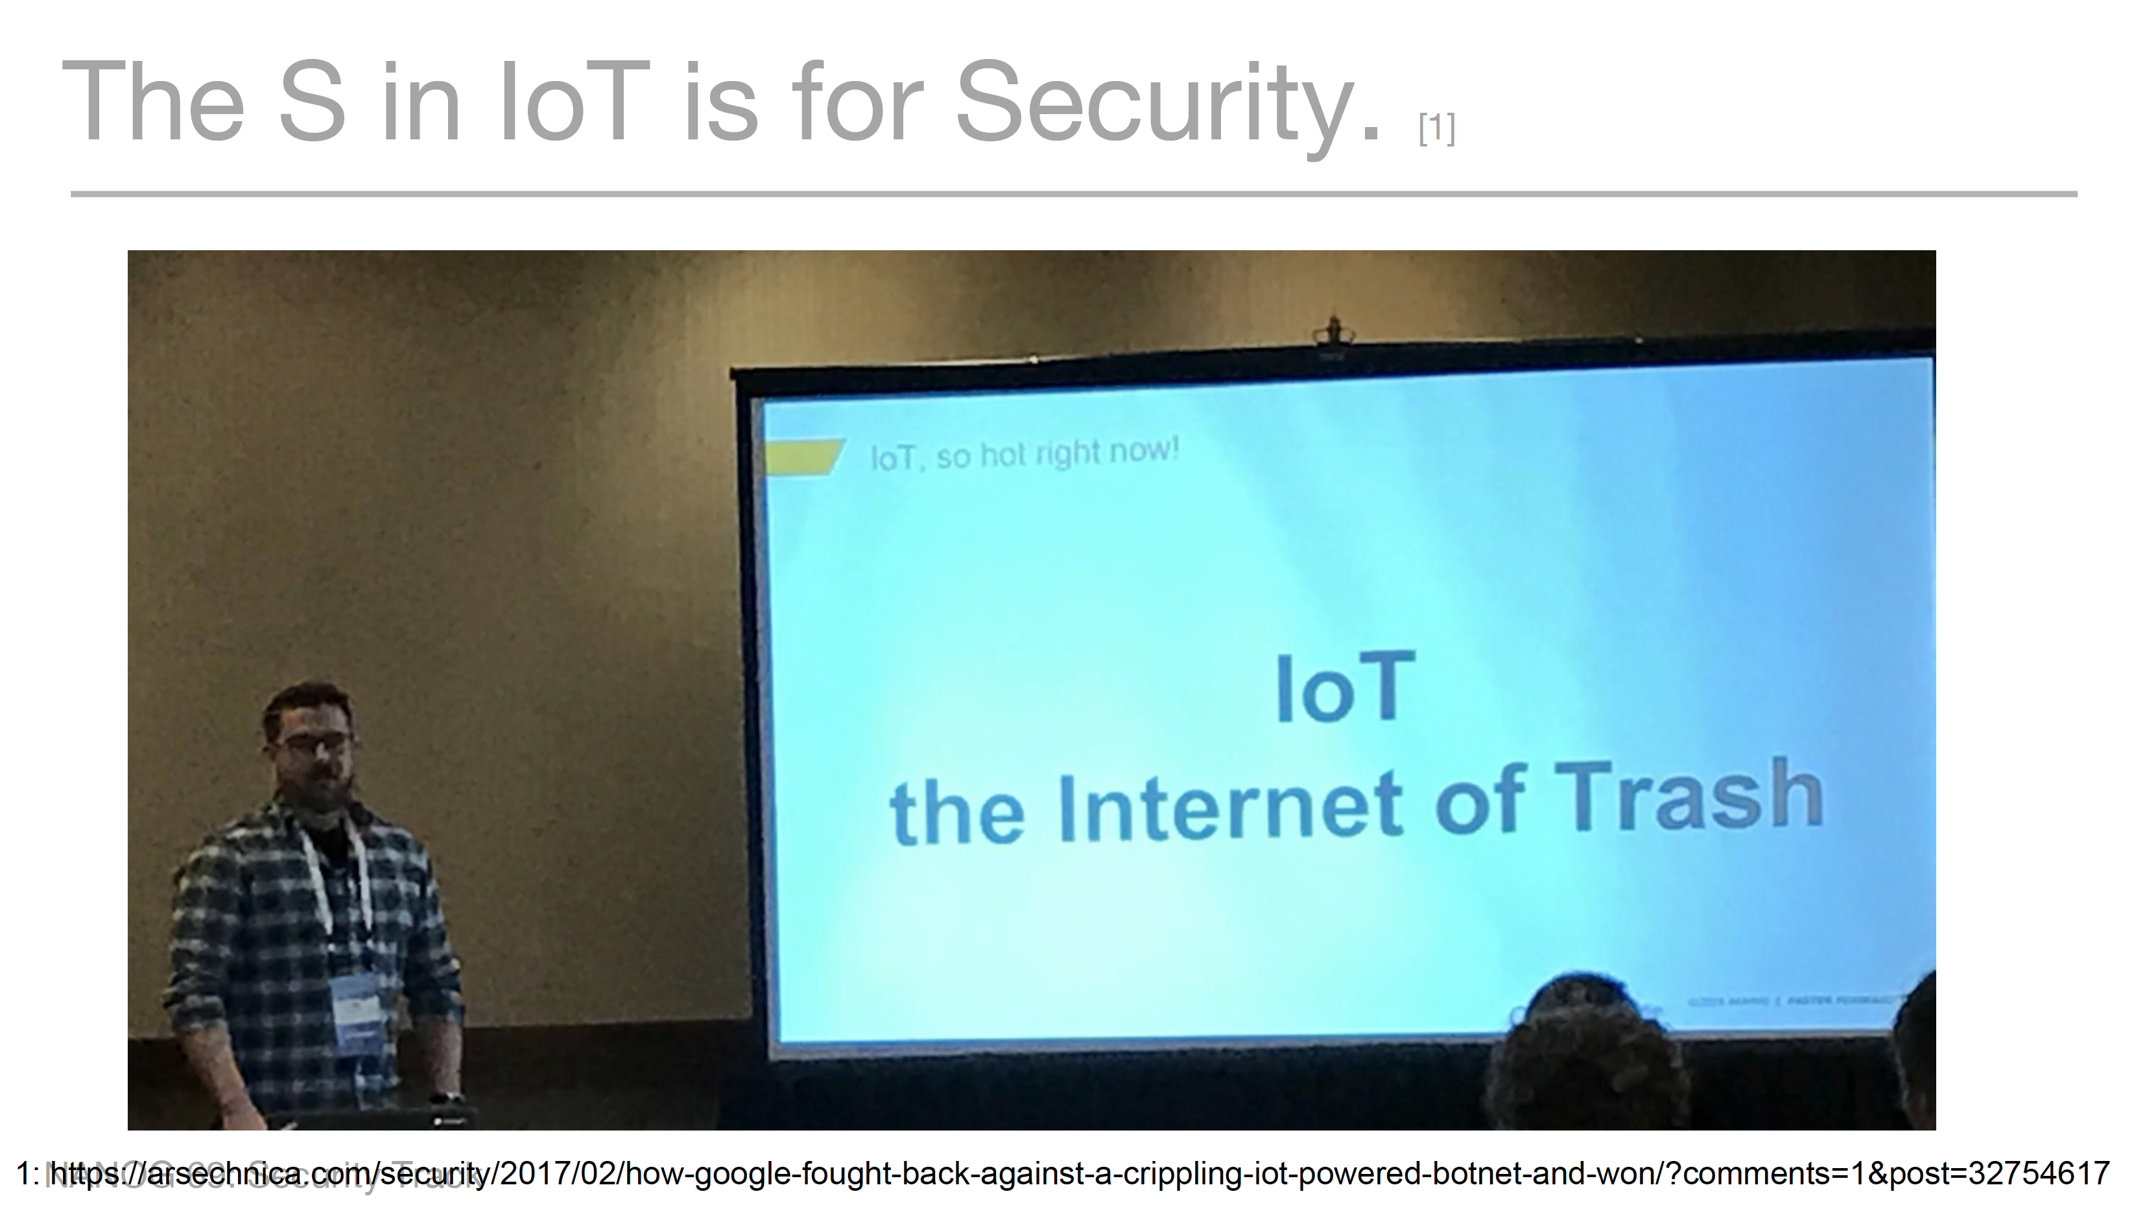
It will only get worse

Slide 22
The Stages of Revolution
Disruption of the Ancien Regime
The Chaos of Revolution
Consolidation through Tyranny

Slide 23
The Rise of Content
Breaking the edge into clients and servers
  Access networks service the needs “clients”
  Clients are not directly reachable by other clients
  Clients connect to services
The role of the network here is to carry clients to the service access point
  The assumption here is that there are many more clients than service points

Slide 24
Content vs Carriage
Who pays whom?
  The only reason why access networks have clients is because there are content services that clients want to access
    Therefore carriage providers should pay for content
  There is no “end-to-end” financial settlement model in the Internet – both “ends” pay for access and network providers settle between themselves. To a carriage network, content is just another client
    Content should pay for carriage, just like any other client

Slide 25
Content vs Carriage
Who pays whom?
  The only reason why access networks have clients is because there are content services that clients want to access
    Therefore carriage should pay for content
  There is no “end-to-end” financial settlement model in the Internet – both “ends” pay for access and network providers settle between themselves. To a carriage network, content is just another client
    Content should pay for carriage, just like any other client
The content folk resolved this fight by going “over the top” and created relationships directly with end users

Slide 26
Content vs Carriage
Service portals are increasingly located adjacent to users
And that means changes to the network:
  Public Networks no longer carry users’ traffic to/from service portals via ISP carriage services
  Instead, Private Networks carry content to service portals via CDN services
This shift has some profound implications for the Internet

Slide 27
Who’s building now?
Almost all new submarine international cable projects are heavily underwritten by content providers, not carriers
Large content providers have huge and often unpredictable traffic requirements, especially among their own data centers. Their capacity needs are at such a scale that it makes sense for them, on their biggest routes, to build rather than to buy. Owning subsea fibre pairs also gives them the flexibility to upgrade when they see fit, rather than being beholden to a third-party submarine cable operator.”
Tim Stronge of Telegeography, January 2017

Slide 28
Today’s Internet Architecture
We’ve split the network into clients and servers
Servers and services now sit in CDN bunkers with global replication and DDOS hardening
Users don’t reach out to content any more - the CDNs bring content to users

Slide 29
Today’s Internet Architecture

Slide 30
Find the Network!
Once the CDN caches sit “inside” the Access ISP then the entire wide area network becomes a marginal activity compared to the value of the content feeds!
If the Internet is (or maybe soon will be) a collection of discrete CDN service ‘cones’ then why do we expect end users to pay for the maintenance of:
  A global address plan?
  A global name system?
  A single global network?

Slide 31
It’s not the Internet we thought it was meant to be!
It’s something else completely
  Service provisioning sits within cloud providers and distributed data centres
  Edge computers are now acting as televisions into the clouded world of data
  The distinction between personal and public data realms is disappearing into the realm of corporately owned private data empires
  Most of the data passed off the network is streaming video

Slide 32
Exactly where are we?
We started this journey building a telephone network for computers to communicate between each other
But now one-way content distribution lies at the core of today’s Internet
This content distribution role is an enterprise service framework rather than a public carriage service
The internal parts of the carriage network are now being privatized and removed from public regulatory oversight

Slide 33

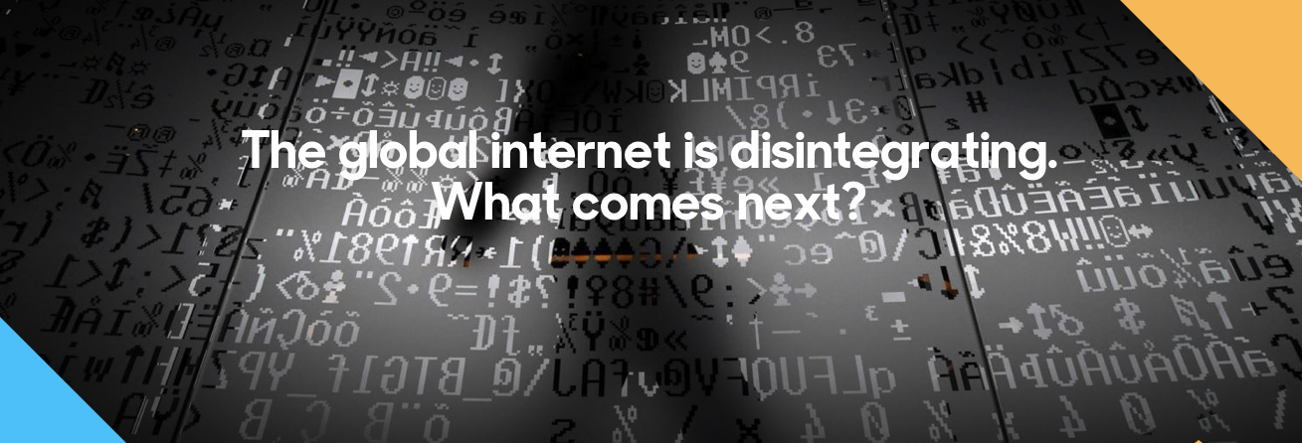

Slide 34
The Stages of Revolution
Disruption of the Ancien Regime
The Chaos of Revolution
Consolidation
Incumbency of the New Regime

Slide 35
Policy?
In today’s Internet what do we mean in a policy sense by concepts such as:
“universal service obligation”
“network neutrality”
“rights of access” or even
“market dominance”
when we are talking about a small set of content providers as the dominant actors in the Internet?

Slide 36







The Large and the Largest
Company | Market Cap (B)
Microsoft | 904
Apple | 895
Amazon | 874
Alphabet | 818
Berkshire Hathaway | 493
Facebook | 475
Alibaba | 472
Tencent | 440
Johnson & Johnson | 373
ExxonMobil | 342
The world’s 10 largest publicly traded companies, as ranked by their market capitalization, Q1, 2019

Slide 37
Content really is King
None of these seven technology companies are a telephone company, or even a transit ISP, or even an ISP at all!
All of them have pushed aside carriage networks in order to maintain direct relationships with billions of consumers
These valuable consumer relationships are based on content services, not carriage

Slide 38
Content Consolidation
There are not thousands of content service platforms
  There are just a few left
And the space is dominated by a small number of dominant actors who set the rules of engagement for all others

Slide 39
Content Consolidation
“The size and scale of the attacks that can now easily be launched online make it such that if you don't have a network like Cloudflare in front of your content, and you upset anyone, you will be knocked offline.
…
In a not-so-distant future, if we're not there already, it may be that if you're going to put content on the Internet you'll need to use a company with a giant network like Cloudflare, Google, Microsoft, Facebook, Amazon, or Alibaba.
…
Without a clear framework as a guide for content regulation, a small number of companies will largely determine what can and cannot be online.
https://blog.cloudflare.com/why-we-terminated-daily-stormer/

Slide 40
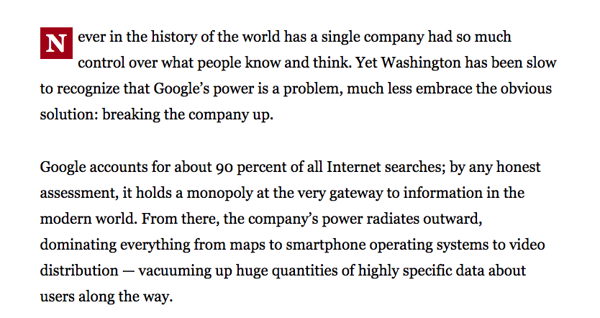
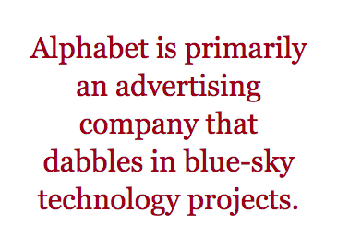
Consolidation?
Boston Globe , June 14 2018

Slide 41
Competition or Cartel?
With a small number of truly massive enterprises at the heart of the area of digital content and service is this still a space that is shaped by competitive pressures?
Or do these dominant incumbents get to set their own terms of engagement with each other, with users, and even with the public sector?

Slide 42
Competition or Cartel?
With a small number of truly massive enterprises at the heart of the area of digital content and service is this still a space that is shaped by competitive pressures?
Or do these dominant incumbents get to set their own terms of engagement with each other, with users, and even with the public sector?
As concerning as this might sound, it’s not a novel situation!

Slide 43
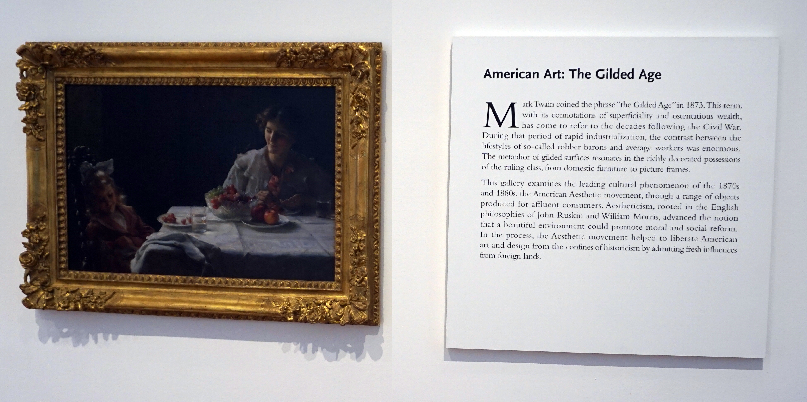
We’ve been here before…
High Museum of Art, Atlanta

Slide 44
The Gilded Age
A term applied to America in the 1870 – 1890’s about the building of industrial and commercial corporate giants on platforms that were a mix of industrial innovation and enterprise with elements of greed, corruption and labor exploitation
Andrew Carnegie - US Steel
John Rockfeller - Standard Oil
Theodore Vail - AT&T
George Westinghouse – Rail Brakes
Thomas Edison – General Electric
J P Morgan - Banking

Slide 45
The Gilded Age
During this period in the United States the dominant position within industry and commerce was occupied by a very small number of players who were moving far faster than the regulatory measures of the day.
The resulting monopolies took the US decades to dismember, and even today many of these gilded age companies remain dominant in their field

Slide 46
The Internet’s Gilded Age
At some point in the past decade or so the dominant position across the entire Internet has been occupied by a very small number of players who are moving far faster than the regulatory measures that were intended to curb the worst excesses of market dominance by a small clique of actors.

Slide 47
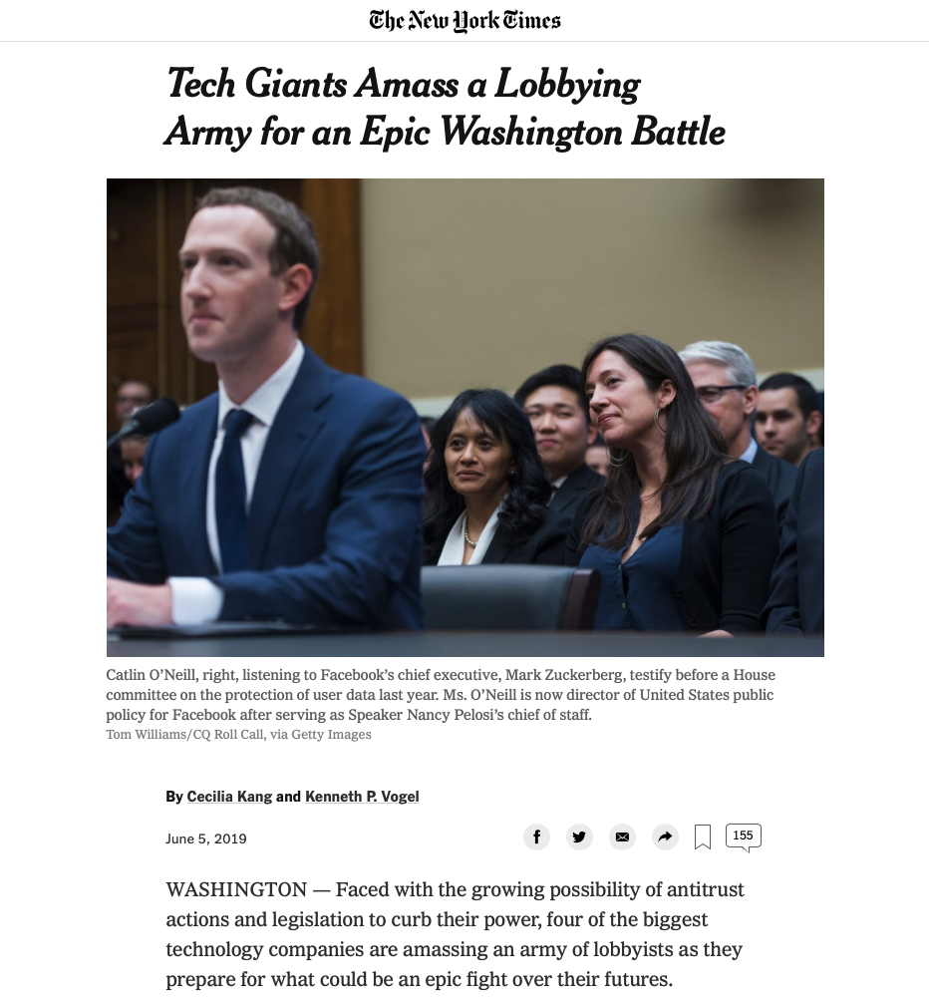
The Internet’s Gilded Age
At some point in the past decade or so the dominant position across the entire Internet has been occupied by a very small number of players who are moving far faster than the regulatory measures that were intended to curb the worst excesses of market dominance by a small clique of actors.

Slide 48
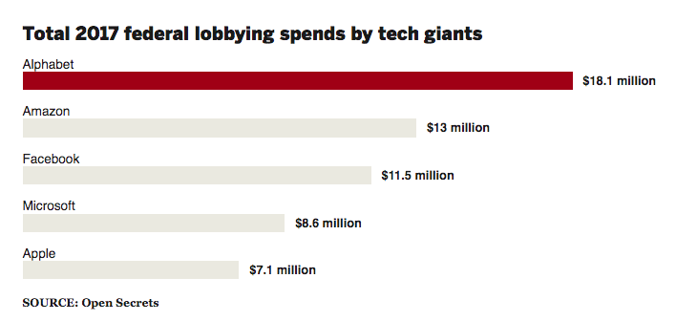
The Internet’s Gilded Age
At some point in the past decade or so the dominant position across the entire Internet has been occupied by a very small number of players who are moving far faster than the regulatory measures that were intended to curb the worst excesses of market dominance by a small clique of actors.

Slide 49
The Internet’s Gilded Age
These actors have enough market influence to set their own rules of engagement with:
  Users,
  Each other,
  Third party suppliers,
  Regulators and Governments
By taking a leading position with these emergent technologies, these players are able to amass vast fortunes, with little in the way of accountability to a broader common public good

Slide 50

The Internet’s Future
Gittes: How much are you worth?
Cross: I've no idea. How much do you want?
Gittes: I just want to know what you're worth. Over ten million?
Cross: Oh my, yes!
Gittes: Why are you doing it? How much better can
you eat? What can you buy that you
can't already afford?
Cross: The future, Mr. Gittes - the future!
Chinatown (1974)

Slide 51
What is this all about?
This is no longer just a conversation about incremental changes in carriage and communications within the Internet.
For me, the essential topic of this conversation is how we can strike a sustainable balance between an energetic private sector that has rapidly amassed overarching control of the digital service and content space, and the needs of the larger society in which we all would like some equity of opportunity to thrive and benefit from the outcomes of this new digital age.
And we should admit the possibility that we are to late to have this conversation in any case!

Slide 53
What’s the problem?
Is it that these enterprises are:
  so big?
  exploitative of their workers?
  distorting markets?
  extracting monopoly rentals from consumers?
  not providing consumers what they want?
No – its none of these …

Slide 54
It’s actually giving us what we want!
It seems that these enterprises have focussed very sharply on giving users precisely what they want
The ability to customise a solution to a market of 1 and still bring economies of scale to that market underlies their success
So we all use these services – because they work for us!

Slide 55
But there are side-effects
In order to understand what each consumer wants, the service provider needs to understand the consumer
Which brings us to…

Slide 56
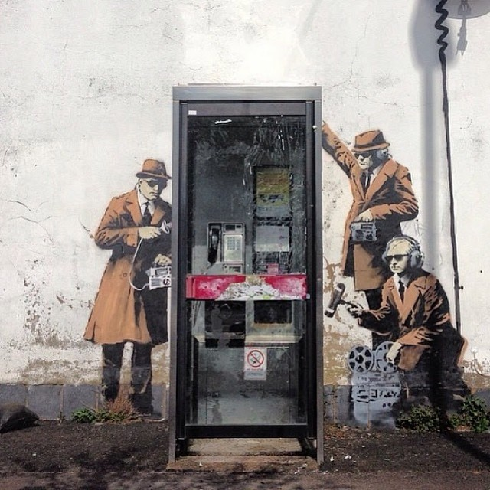
Surveillance Capitalism
Much of the wealth and impact of these activities is built upon a foundation of aggregation of individual user behaviour and construction of personal profiles
It also has benefitted from a cavalier attitude towards data security and privacy concerns and the absence of regulatory imposts that attempt to safeguard some basic common aspects of personal privacy

Slide 57

Is this what we want?

Slide 58
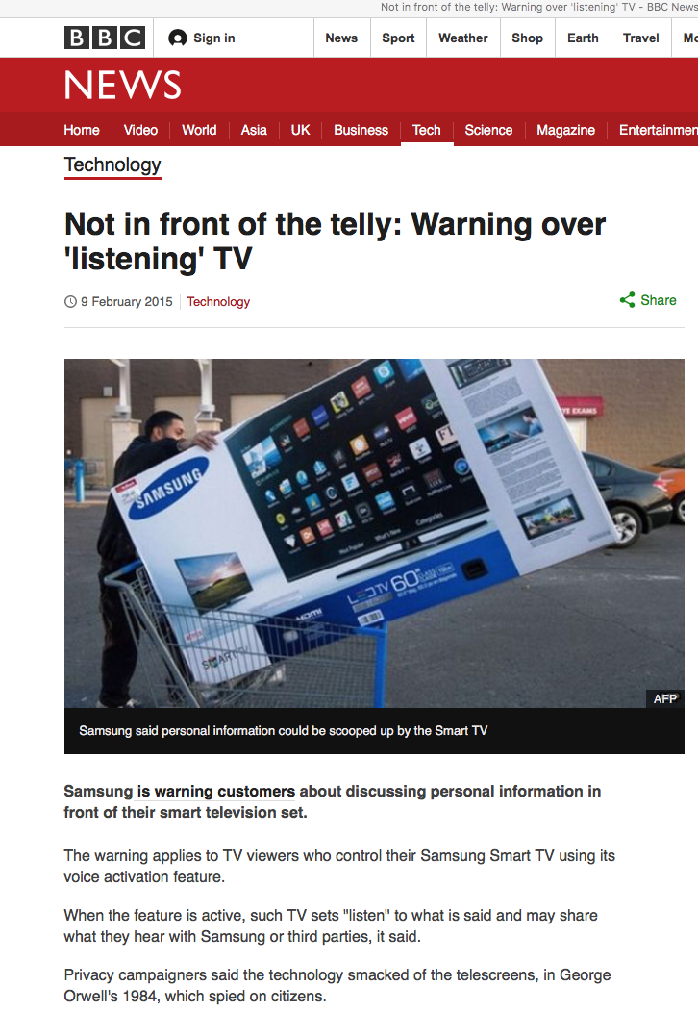
Is this what we want?

Slide 59
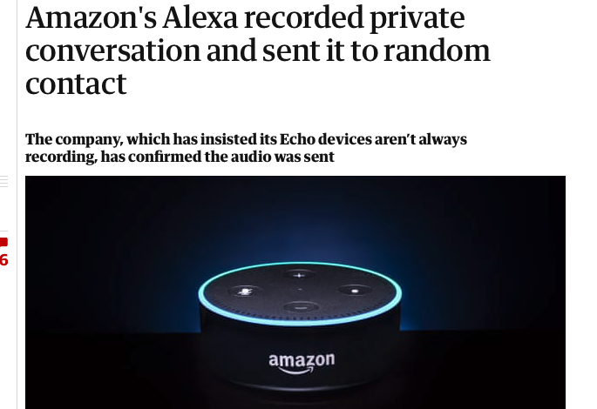
Is this what we want?

Slide 60
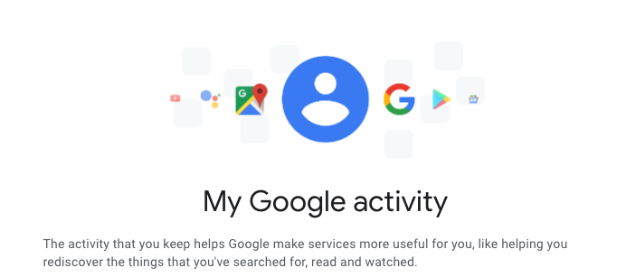
Is this what we want?

Slide 61
What we might want
There is a common view that this is a classic case of market failure
Markets don’t normally correct themselves in times of failure – normally the public sector is there to regulate behaviours in markets to protect the public interest

Slide 62
Some questions
An effective regulatory regime should be able to provide clear answers to these questions:
  Who owns my personal profile data?
  Where is it stored?
  What regulatory regime protects it?
  Should I be informed when my profile is sold?
  Do I have an informed valuation of my personal profile?
  Who is at fault if my personal data is leaked?

Slide 63
Where are we?
Its clear we’re not in Kansas any more
And whatever the Internet may be, it’s not a telephone network for computers
Its now a platform of the projection of unprecedented power across the entire landscape of human activity by a small clique of savvy operators

Slide 64
Where are we?
We are now communicating with a computer-mediated environment rather than with each other
The network itself is largely incidental to this evolving story, and this is not really about the Internet any more
It’s about a set of revolutionary social changes on a par with the industrial revolution that have been triggered by abundant computing, storage and comms
And its dominated by a very small cartel of monopolists

Slide 65
Where are we?
We are now communicating with a computer-mediated environment rather than with each other
The network itself is largely incidental to this evolving story, and this is not really about the Internet any more
It’s about a set of revolutionary social changes on a par with the industrial revolution that have been triggered by abundant computing, storage and comms
And its dominated by a very small cartel of monopolists
“Every monopoly and all exclusive privileges are granted only at the expense of the public interest”
Andrew Jackson, 1830

Slide 66
Where are we?
We are now communicating with a computer-mediated environment rather than with each other
The network itself is largely incidental to this evolving story, and this is not really about the Internet any more
It’s about a set of revolutionary social changes on a par with the industrial revolution that have been triggered by abundant computing, storage and comms
And its dominated by a very small cartel of monopolists
“Every monopoly and all exclusive privileges are granted only at the expense of the public interest”
Andrew Jackson, 1830
Government by organised money is just as dangerous as government by organised mob
Franklin D Roosevelt, 1936

Slide 67
Maybe its worse than that
In a world of abundant content what do we choose to view?
What do we choose to believe?
Search becomes the arbiter of content selection and assumes a level of ultimate importance in this world
What’s the social outcome of search being dominated by a single entity?

Slide 68
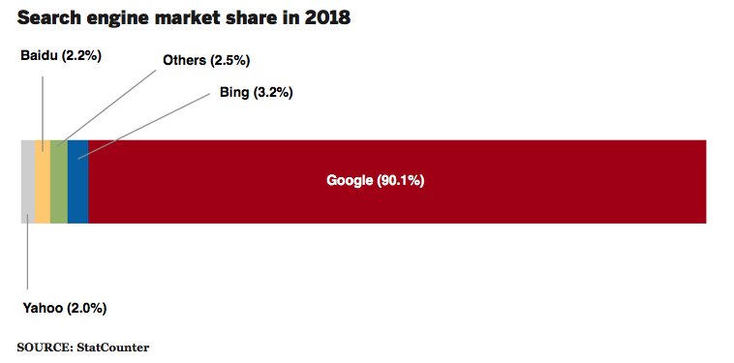
Is it about what we buy or is this really about what we think?
Share of search in US market

Slide 69
Where does all this head?
For our society, this rapid market-driven digitisation of our world has the potential to be incredibly empowering or incredibly threatening
Or both at the same time!

Slide 70
Wherever we’re heading…
It’s not the Internet any more
That has already died and gone to silicon heaven!

Slide 71

Sic transit gloria mundi
In 1776 English historian Edward Gibbon published a mighty 6 volume work tracing the Roman Empire (and Western Civilisation) from the height of Empire to the fall of Byzantium
The seeds of of the empire’s eventual decline and fall were sown early in its rise

Slide 72
Thanks!

